Slide 1

War & Climate Change: Impacts & responses in Tenasserim region, Myanmar “Indigenous People Protecting Forests And Finding Practical Solutions For Climate Change Mitigation”
Seventeenth International Conference on Climate Change: Impacts & Responses
Florida International University Miami, United States of America Jan 23, 2025 – Jan 25, 2025
Presented by Saw Frankie Abreu

Slide 2
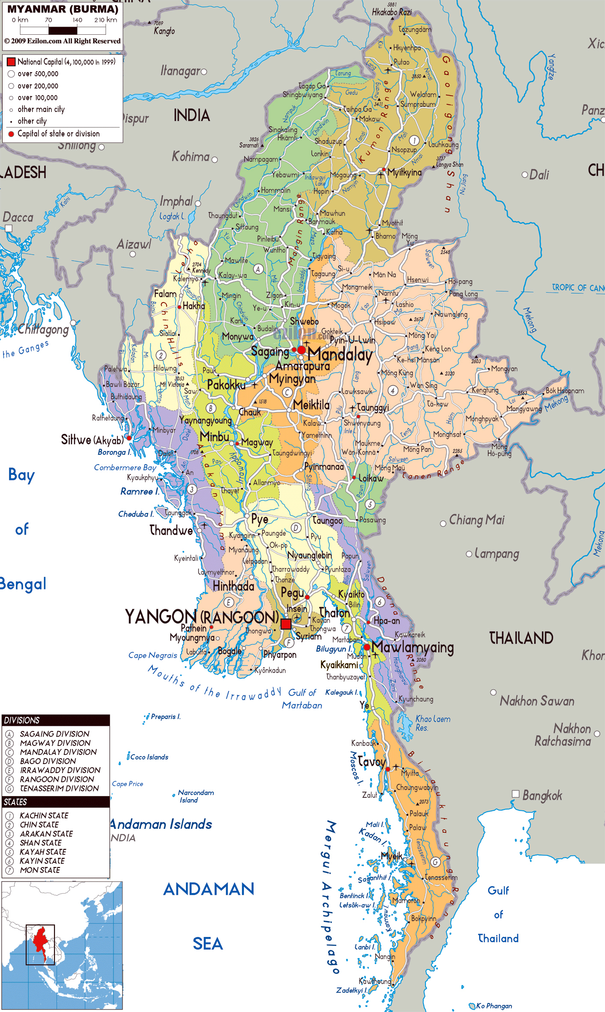
Myanmar/Burma overview
In Southeast Asia; borders India, China and Thailand.
10 years of partial political and economic reform from 2010-20.
Military attempted coup in 2021, but they have not been able to consolidate full territorial control.
On-going multiple-front civil war causing death and displacement, and disrupting the economy.
Multiple ethnic groups living in different areas; many of which identify as Indigenous Peoples.
The forest cover is 42% of country’s total land.

Slide 3
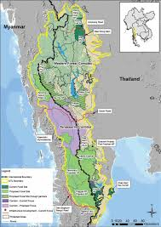
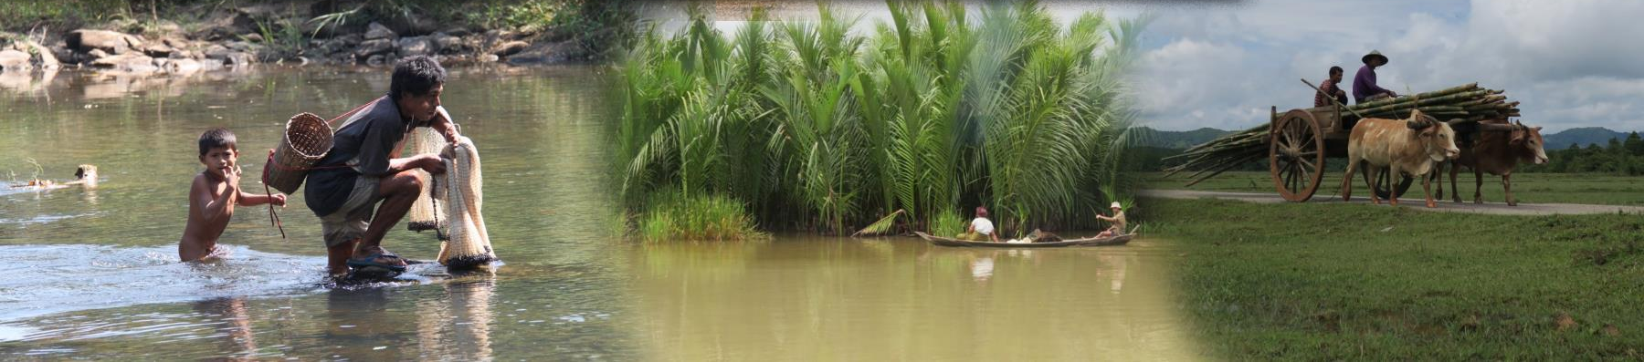
Dawna Tenasserim Landscape (DTL)
DTL is one of the earth’s remarkable biodiversity eco-regions.
69,000 square miles (approximate size of North Dakota).
TRIPNET’s project area is located in Tenasserim Region, southern Myanmar, between the Western Forest Complex of Thailand and the Andaman sea.
TRIPNET was established in 2014 during the democratic transition period in Myanmar.

Slide 4
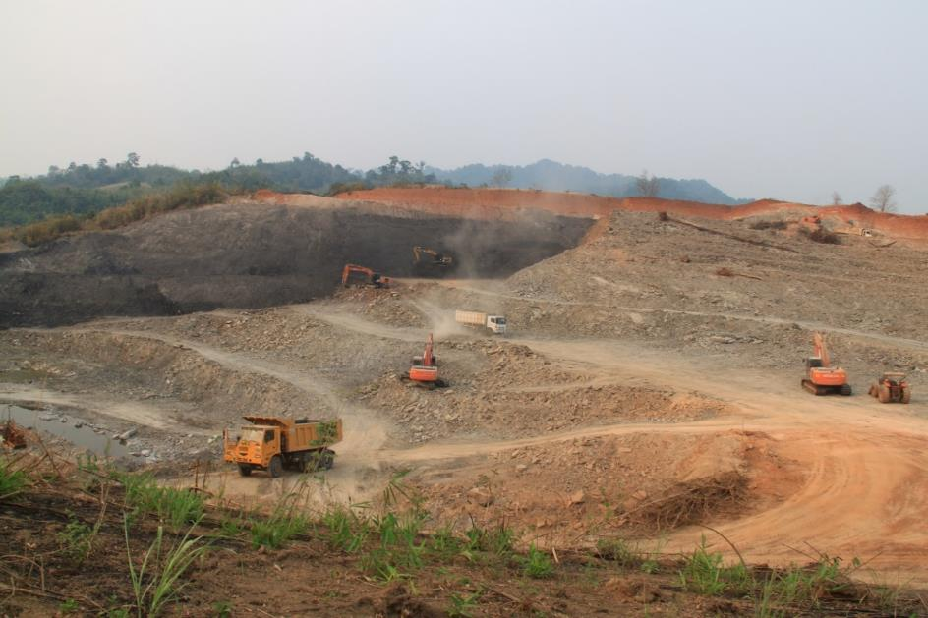
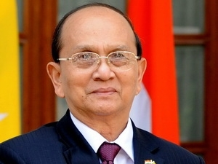
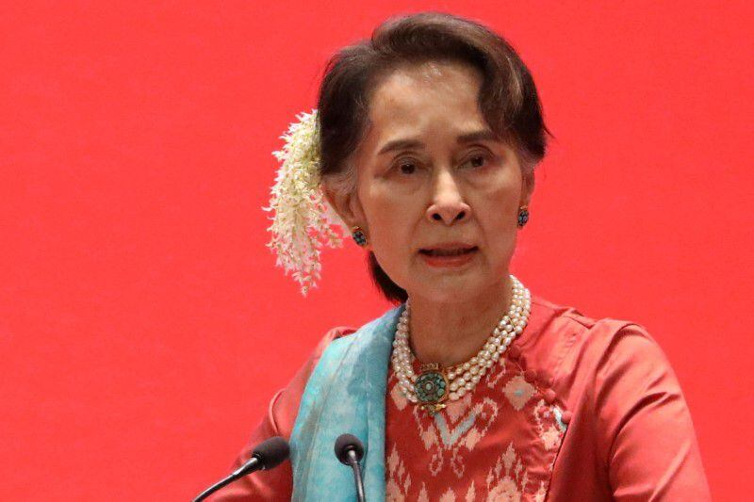
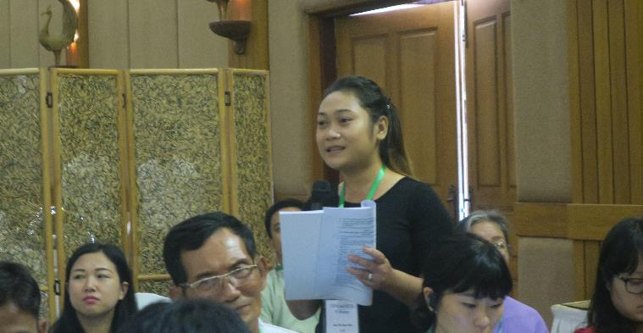
Indigenous People’s movements in Myanmar/Burma
(2010-2020)
Elections held in 2010, following two decades of military dictatorship. Military ensured their continued grip on power with the 2008 constitution.
Partial democratic transition period had ‘open-door’ investment policy, especially in natural resource sectors.
Investments flooded into IP territories, causing negative social impacts and environmental degradation (land confiscation, water and air pollution, etc.)
IP communities and CSOs rejected several mega-projects using FPIC frameworks and patchwork of domestic laws.
IP communities and CSOs were involved in some national-level legal reform discussions (National Land Law, Biodiversity Conservation & Protected Areas Law, etc.)
General Thein Sein 2010-2015
Extractive Industries
Aung San Suu Kyi 2016-2021
CSO representatives participated in law drafting

Slide 5
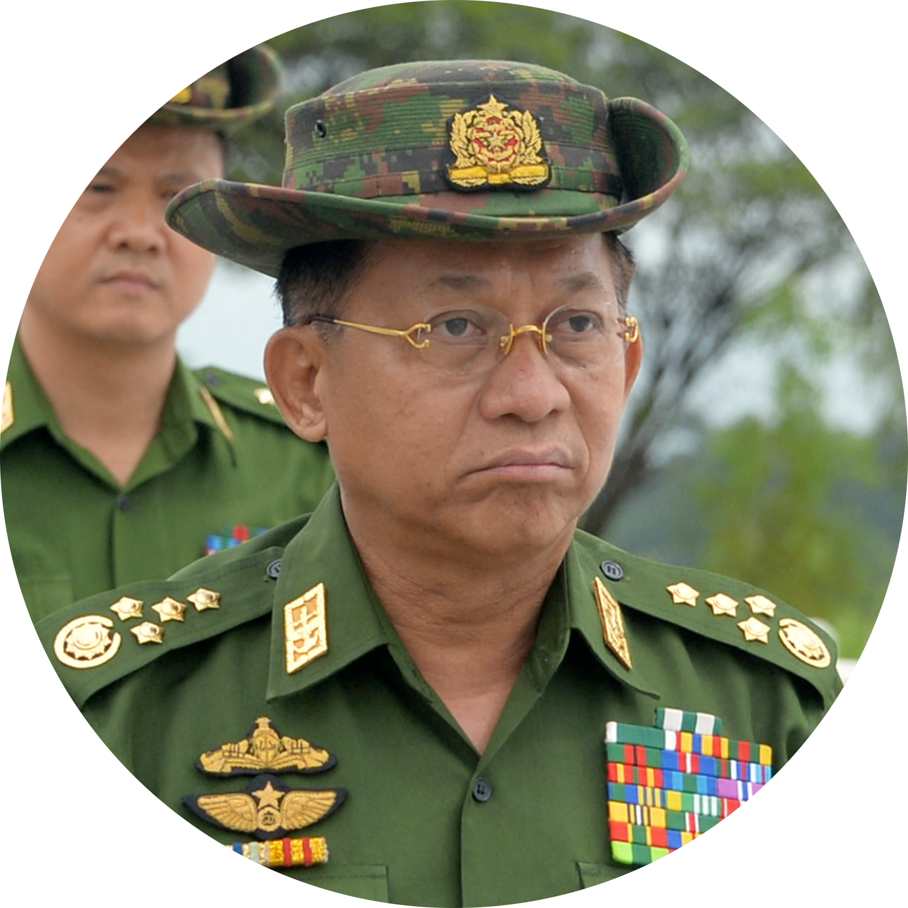
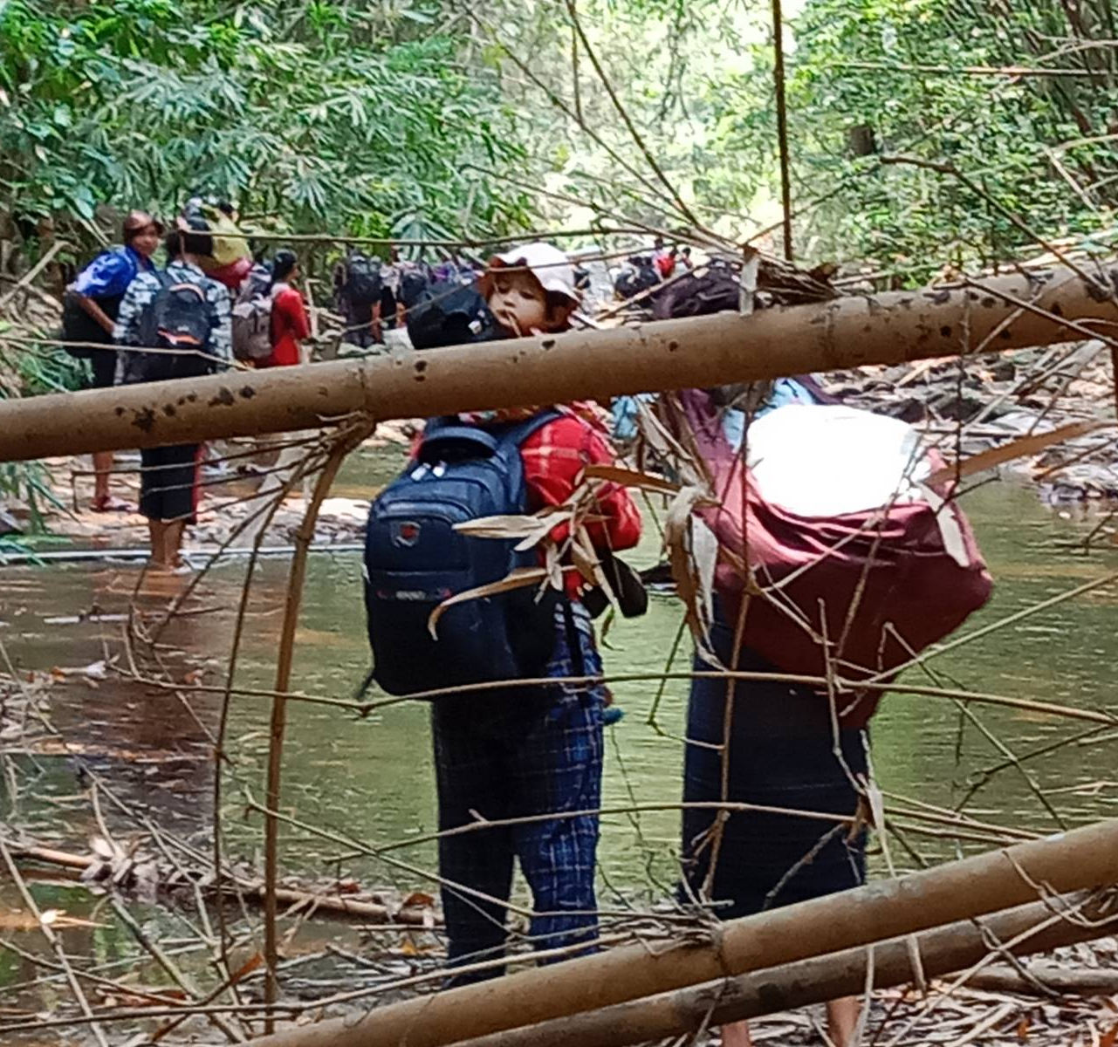
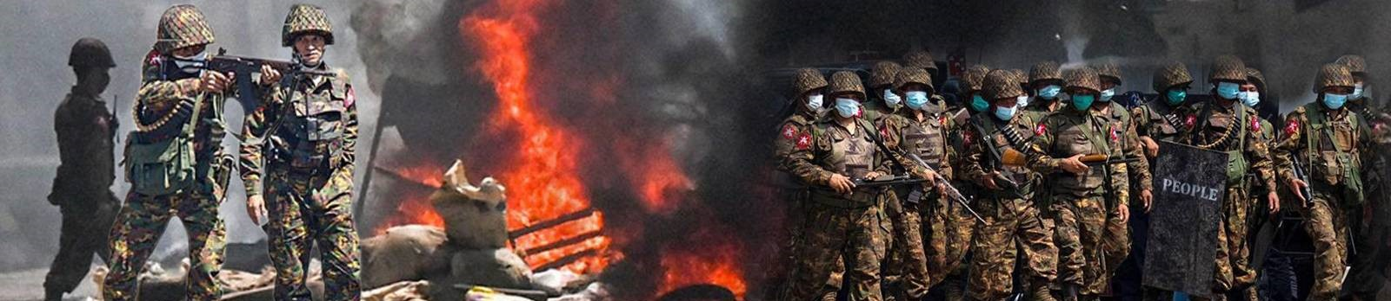
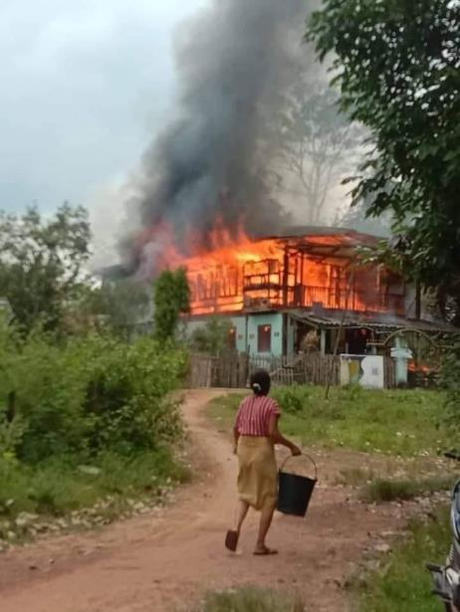
The darkness of democracy after the military coup 2021
Claiming election fraud, the military conducted an attempted coup on 1st February 2021.
Vast majority of people rejected the coup, and joined peaceful protests on the streets.
Many civil servants and government officials joined a general strike action called the Civil Disobedience Movement (CDM).
Several thousand young people have joined People’s Defense Forces (PDF) to fight the military regime.
Over 5,000 civilians killed, over 3.5 million people are currently internally displaced, and over 21,000 political prisoner are currently detained.
Massive internal and international displacement due to the armed conflict, a new Military conscription law, and poor economy.
Senior General Min Aung Hlaing

Slide 6
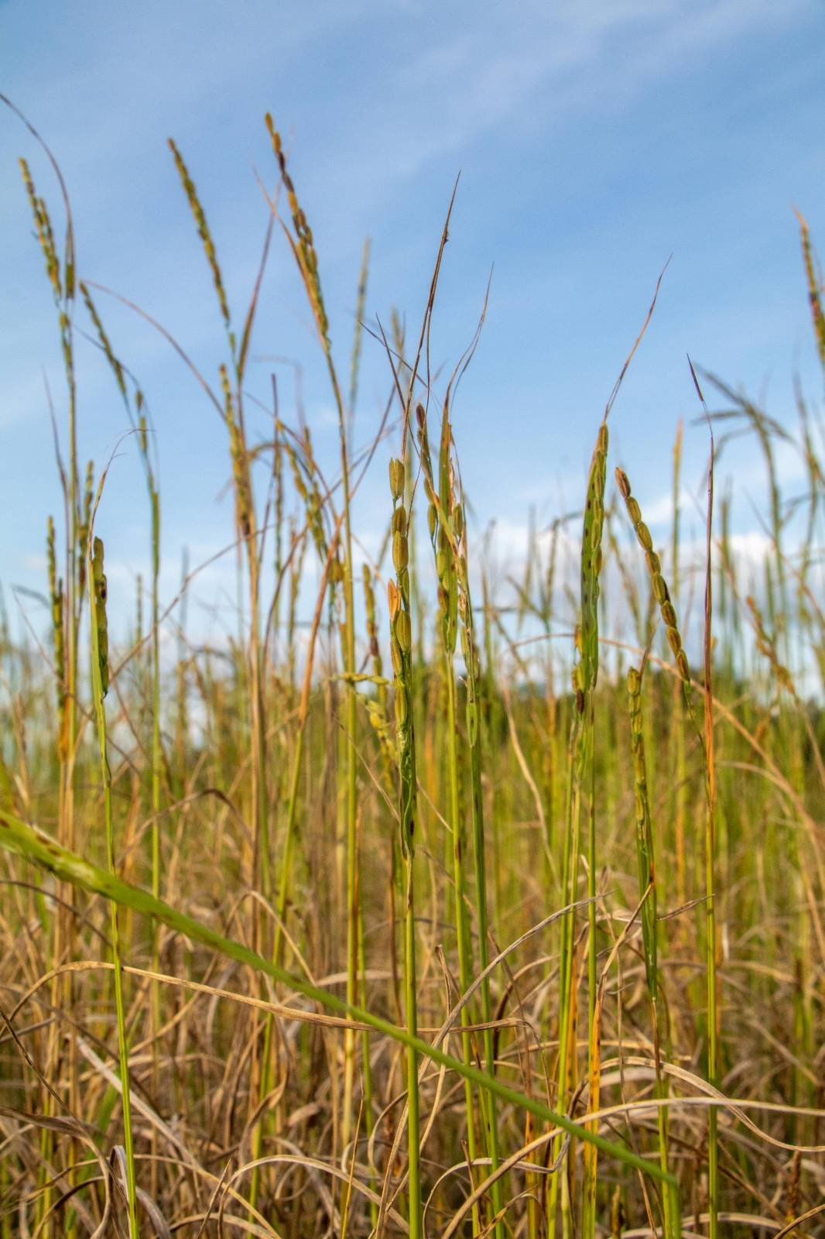
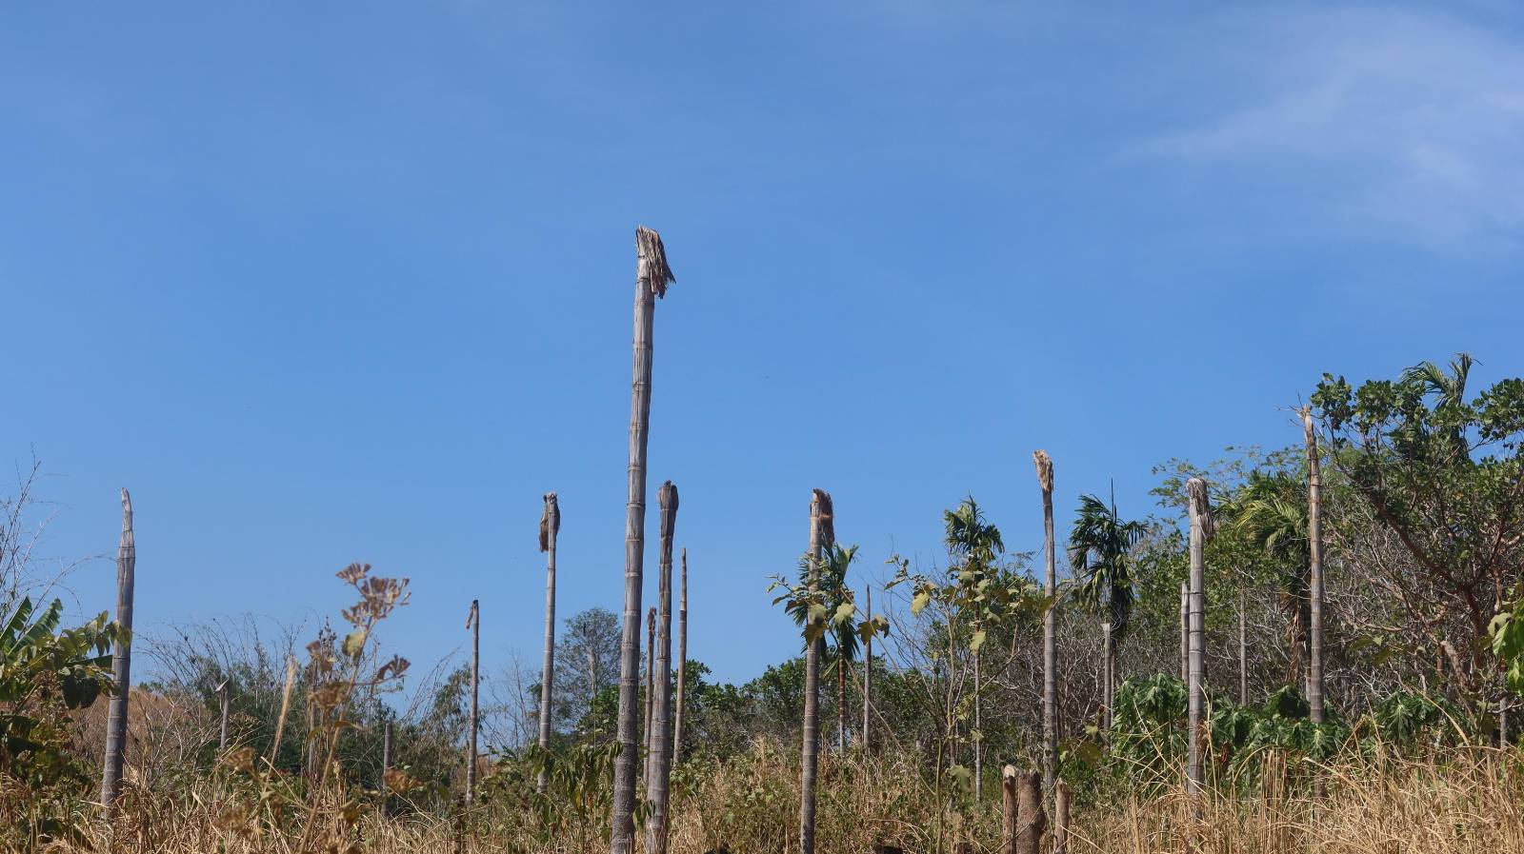
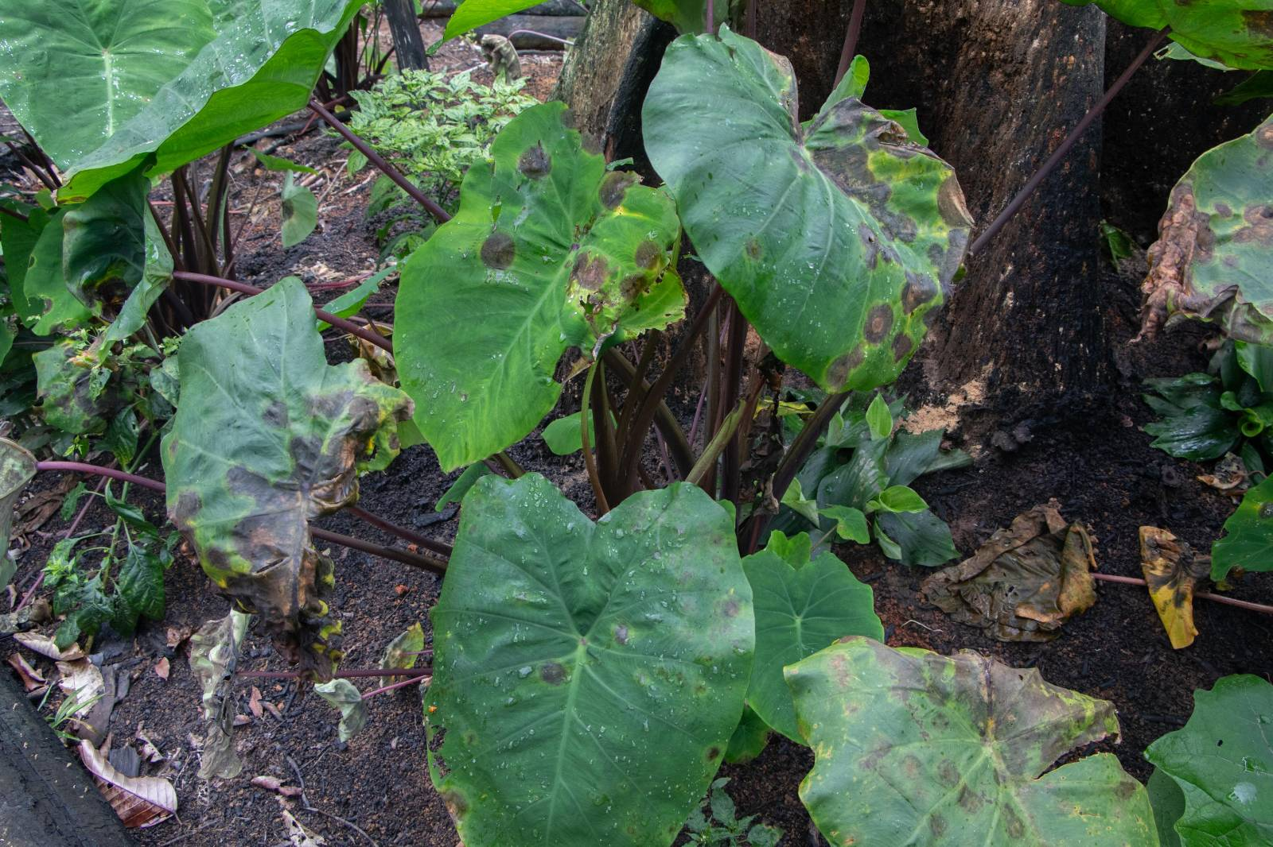
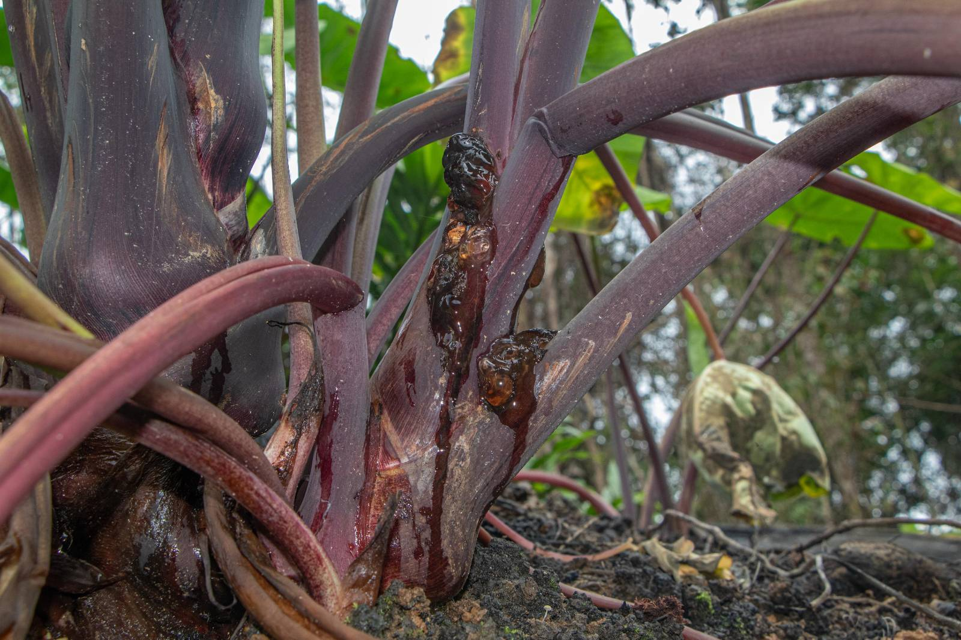
Vulnerabilities to impacts from climate change
Severe droughts have destroyed ground crops and fruit tree orchards, disrupted harvests due to immature fruiting, and caused forest fires.
Severe flooding in rural areas has led to low yields, destroyed seed stocks, and increased spread of pest insects and diseases.
Forest-dependent communities in rural areas have reacted to these climate impacts combined with the realities of on-going civil war by clearing more forested land for cultivation.
The clearing of forests has resulted in additional negative impacts to rivers, soil, and wildlife.

Slide 7
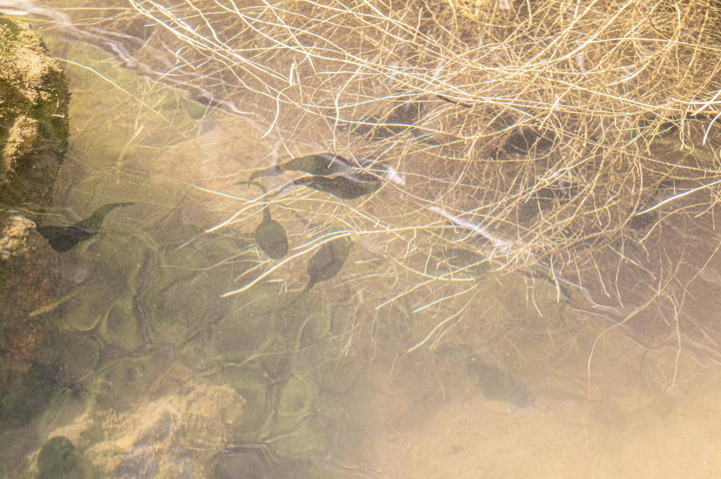
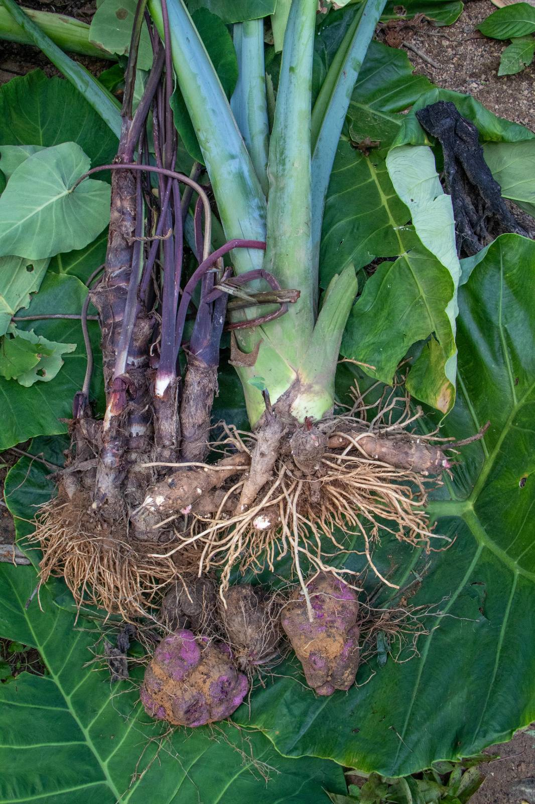
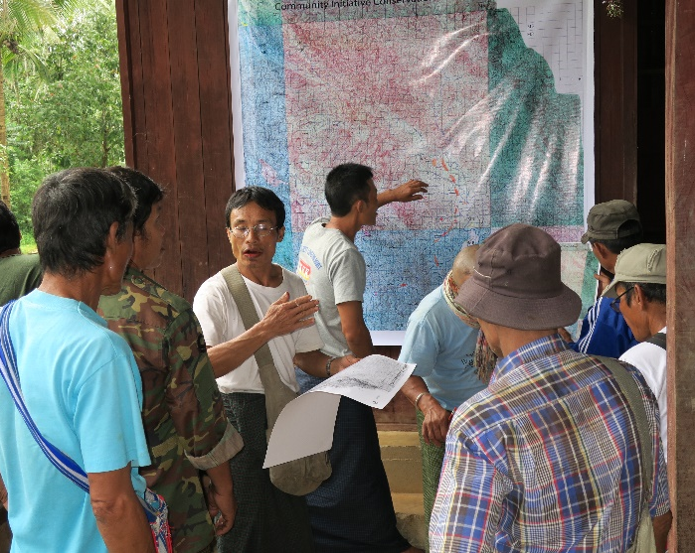
Local solutions for mitigation and adaptation
Participatory biodiversity assessments
Climate-smart production
Establishment of Community Protected Areas

Slide 8
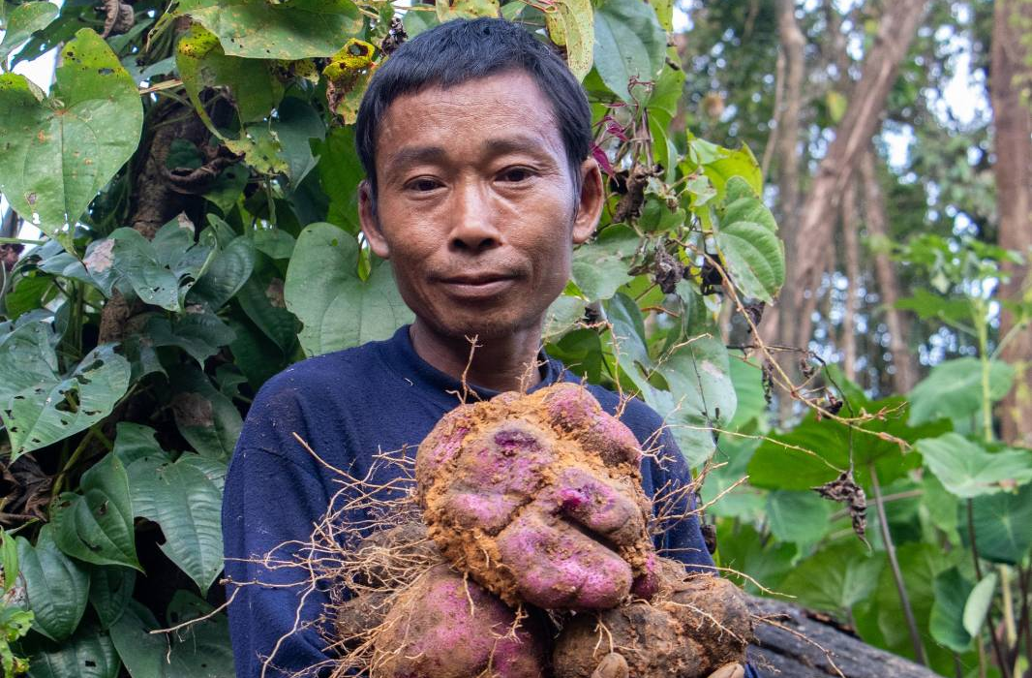
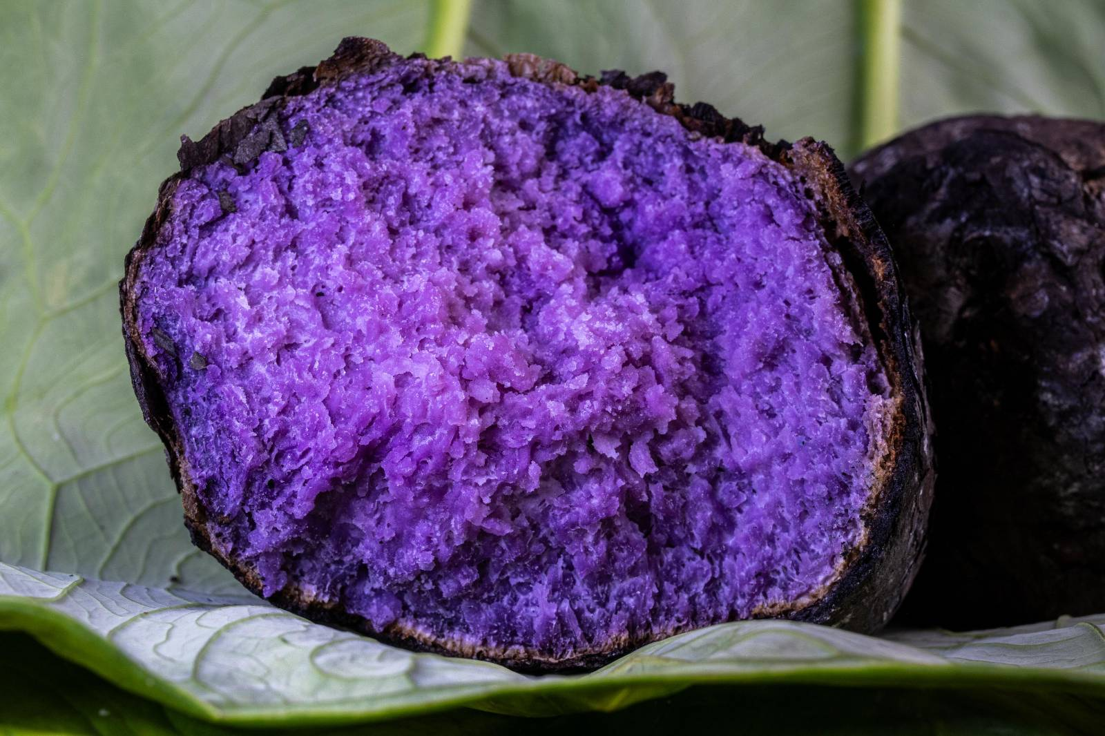
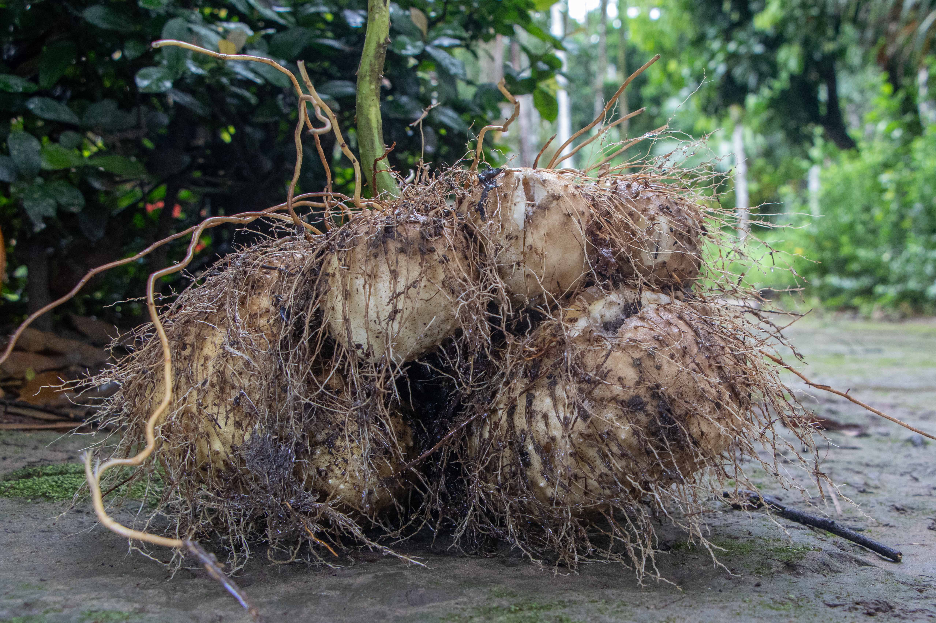
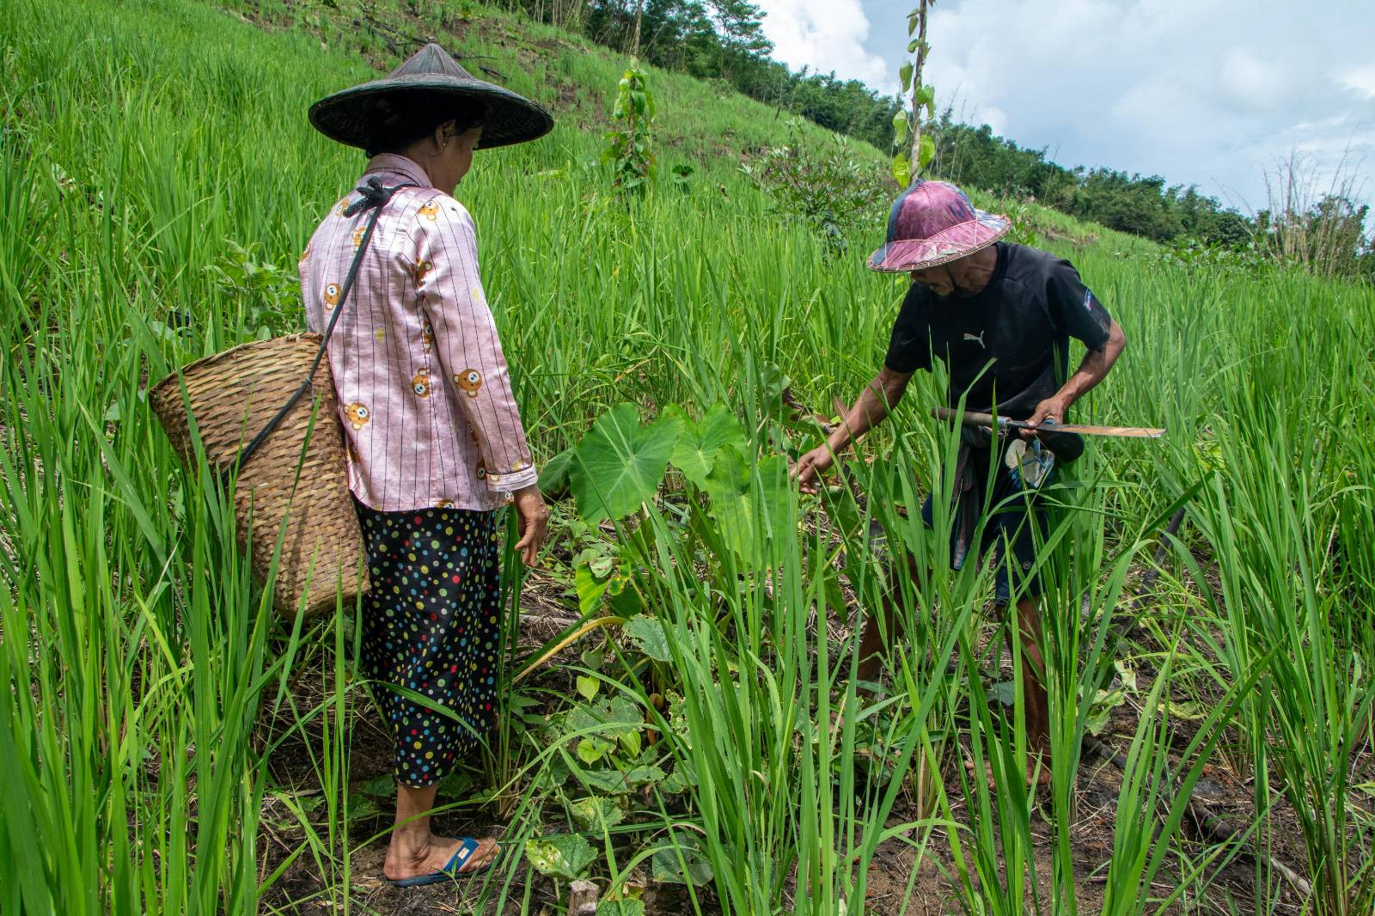
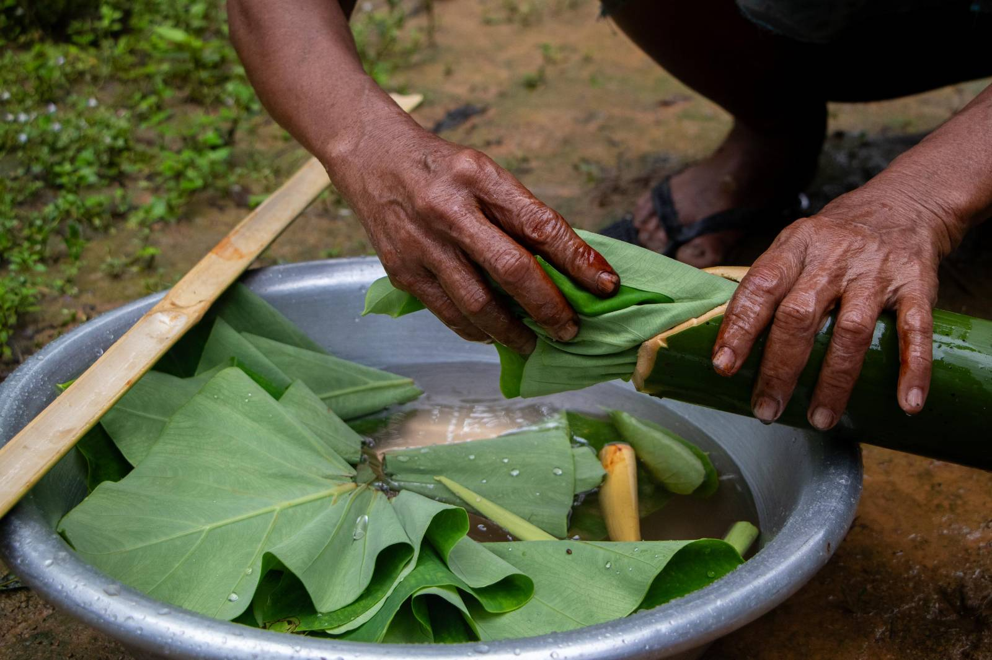
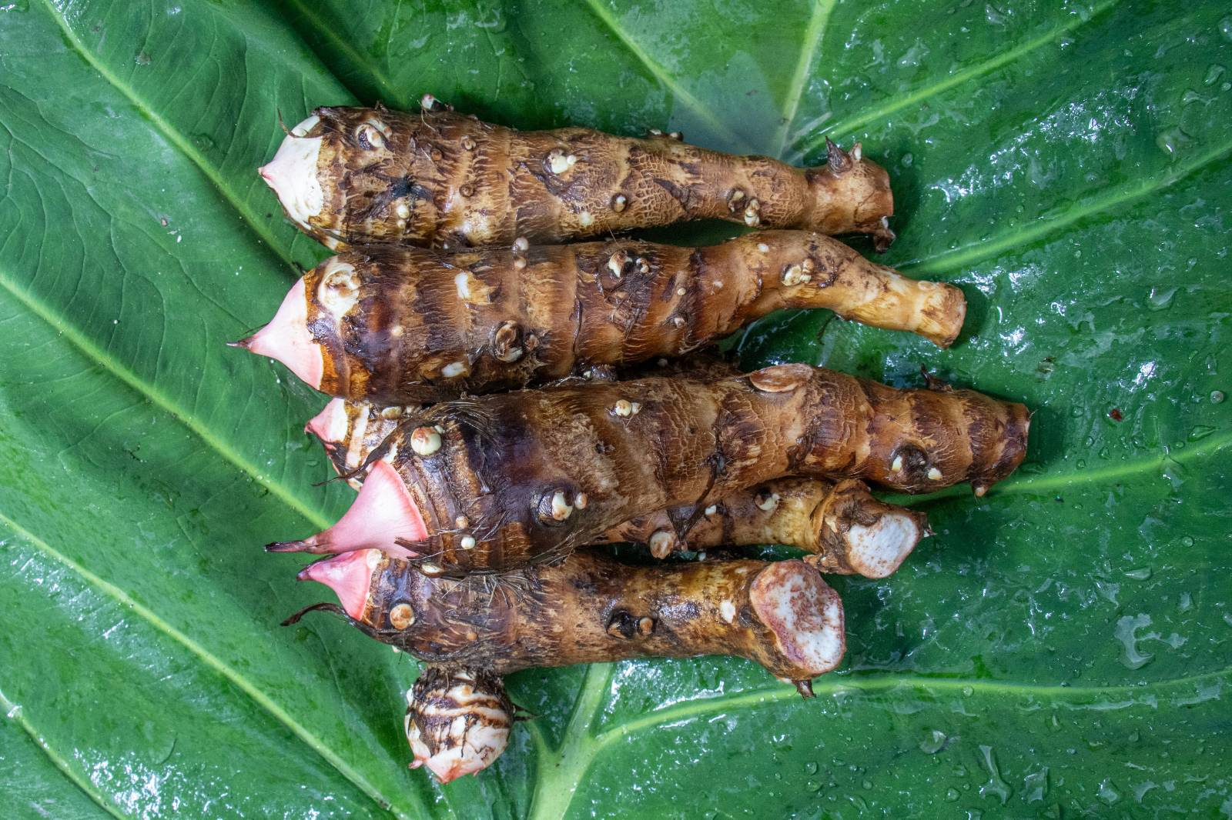
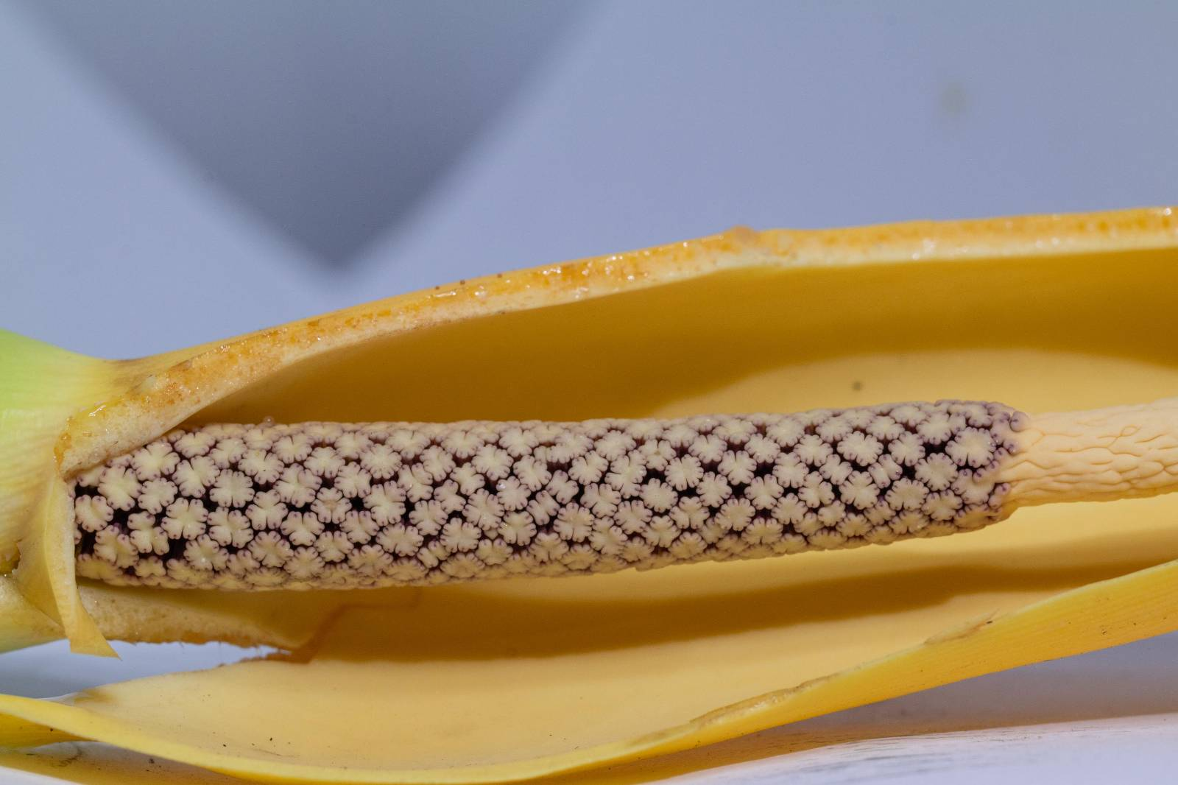
Climate-Smart Production
Reintroduction of local heritage seed varieties which are resilient.
Collection of oral stories / traditional knowledge on ecology and agriculture from elders.
Living seed banks produce seed stocks which are distributed to rural communities and internally displaced people.

Slide 9
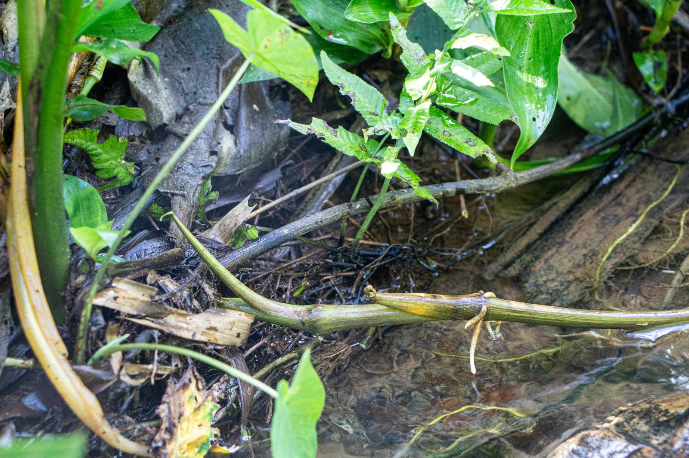
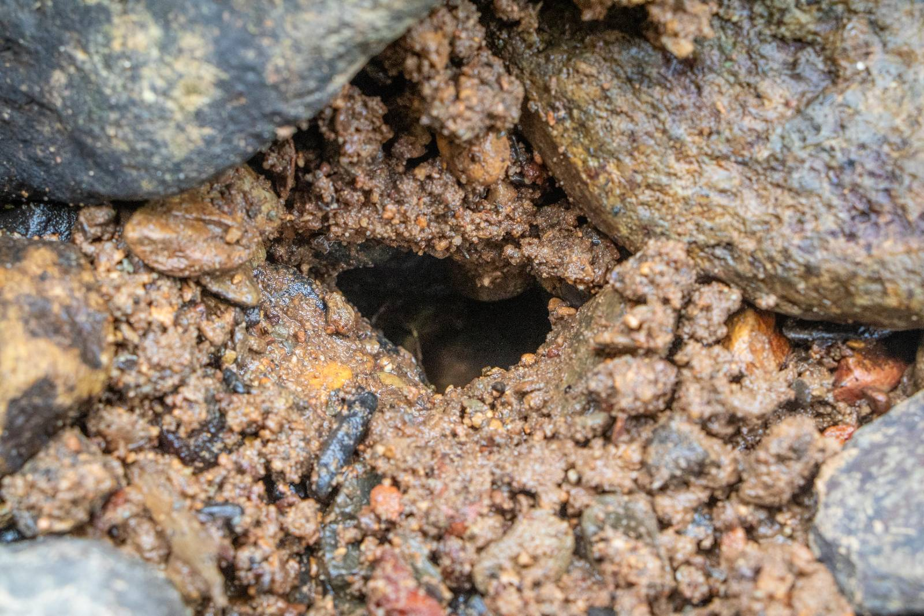
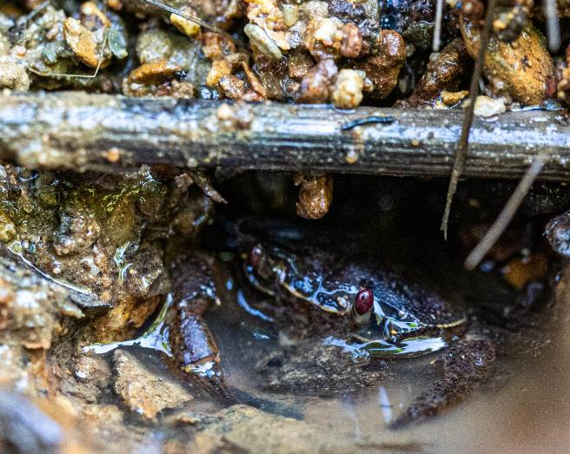
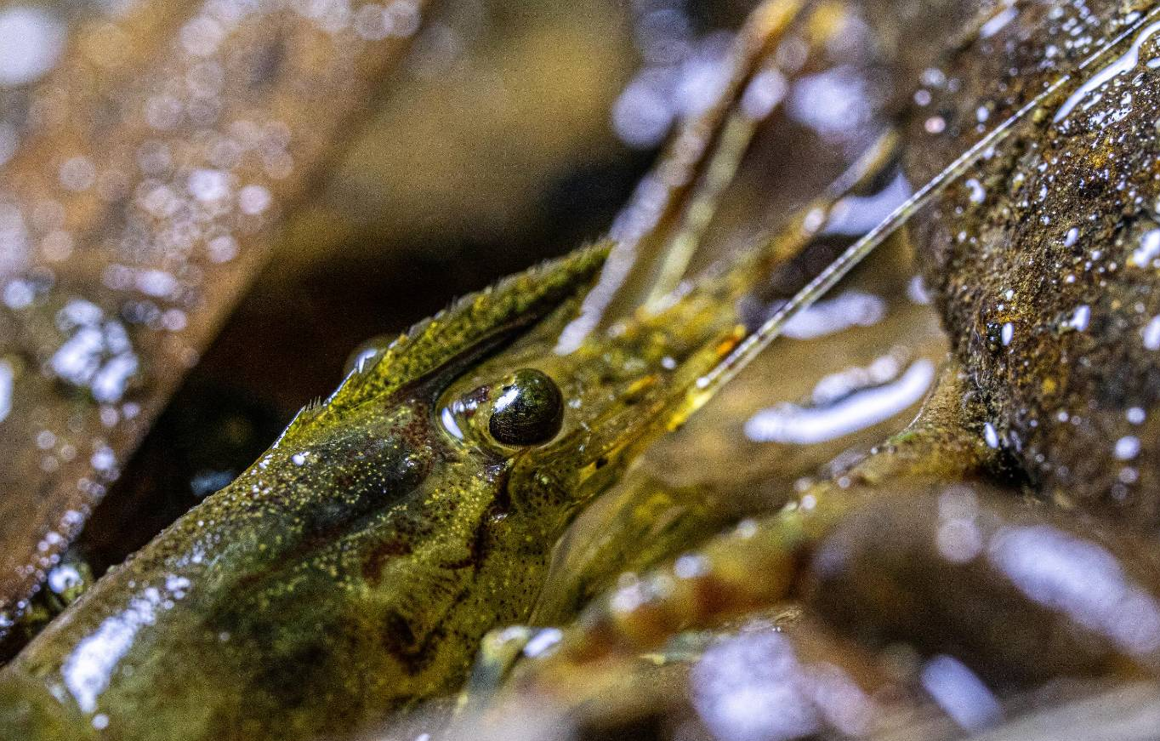
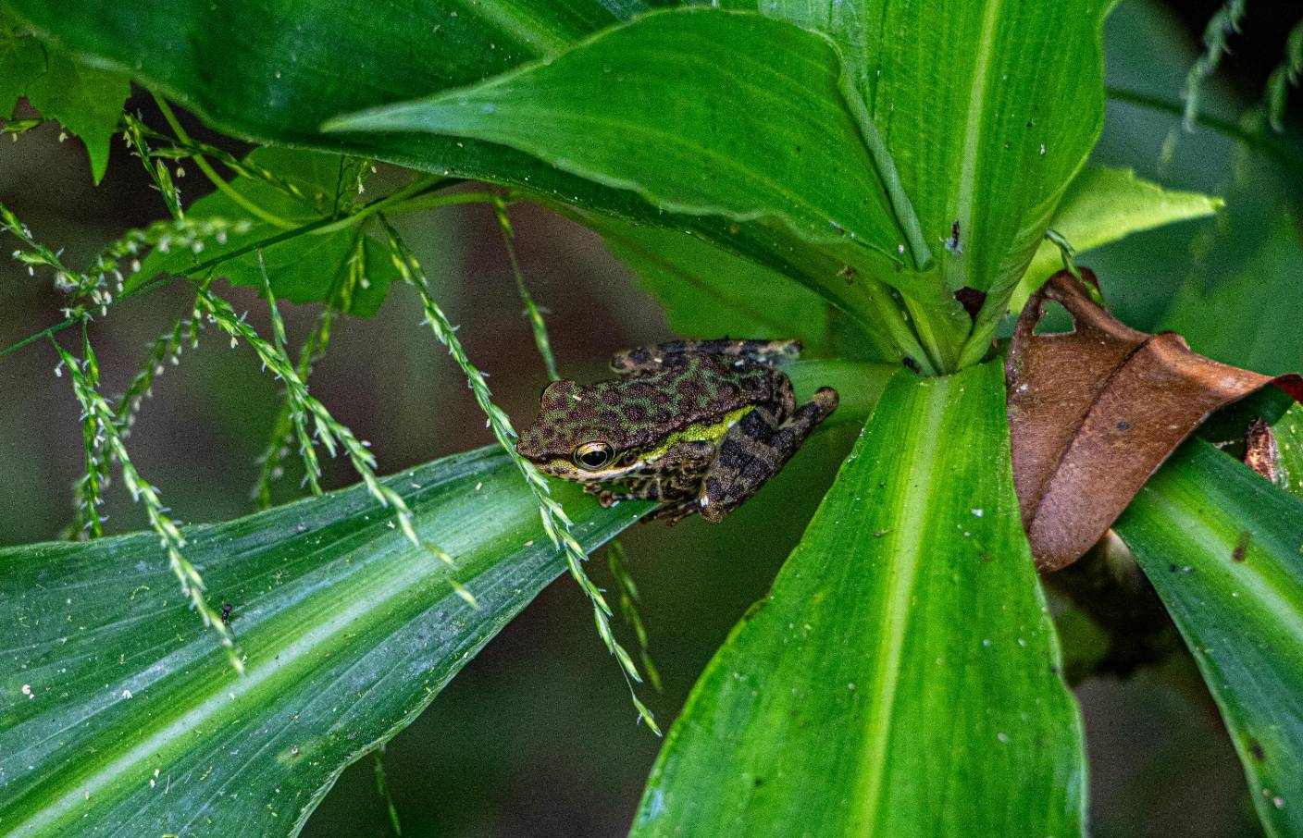
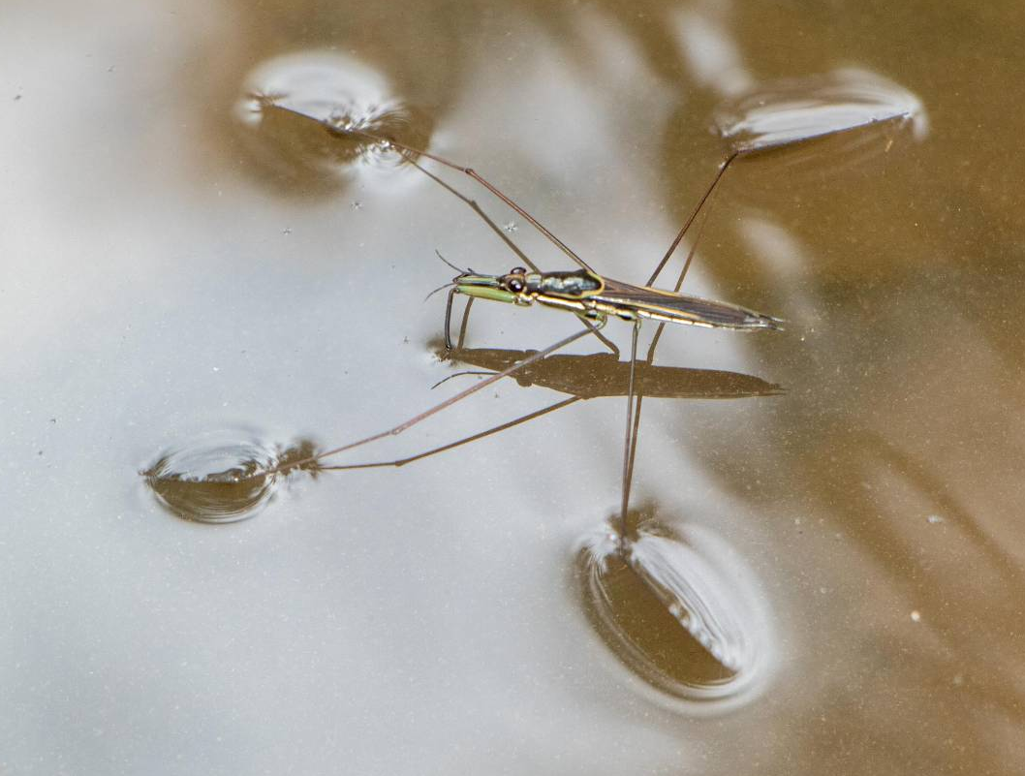
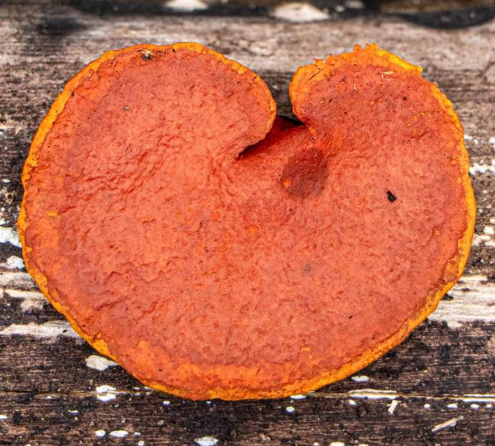
Participatory biodiversity assessments (e.g. watershed forest spring ecology)
Aquatic creatures living in a watershed forest are extremely important for its ecology.
Local experts and knowledge owners are recruited, and decide on specific topics for the assessments.
Indigenous people conduct field assessments and collect samples of local forest resources.
The assessment team works with local elders to identify the species and local names of the samples.
Species photos used to design materials that promote importance of conservation of natural resources among local communities.

Slide 10
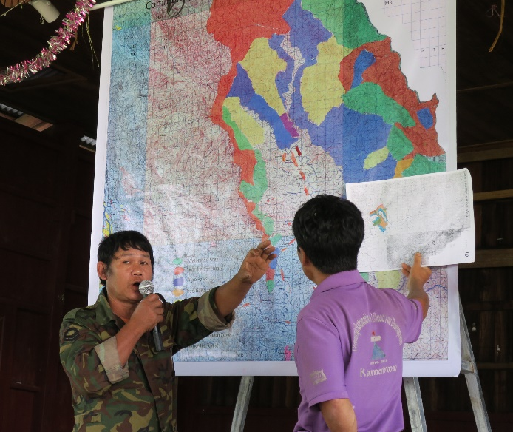
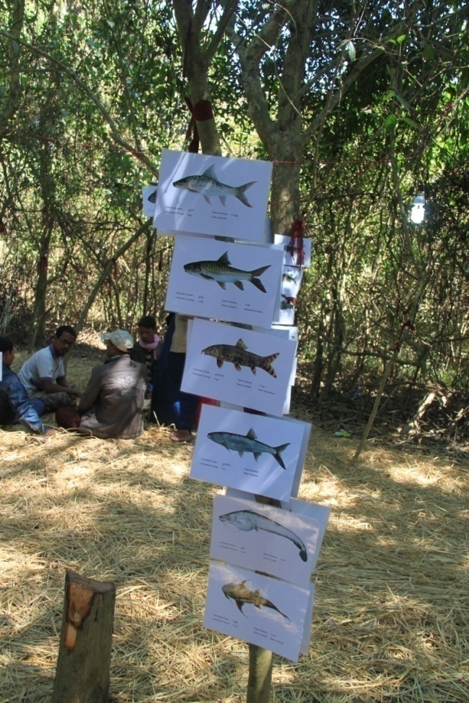
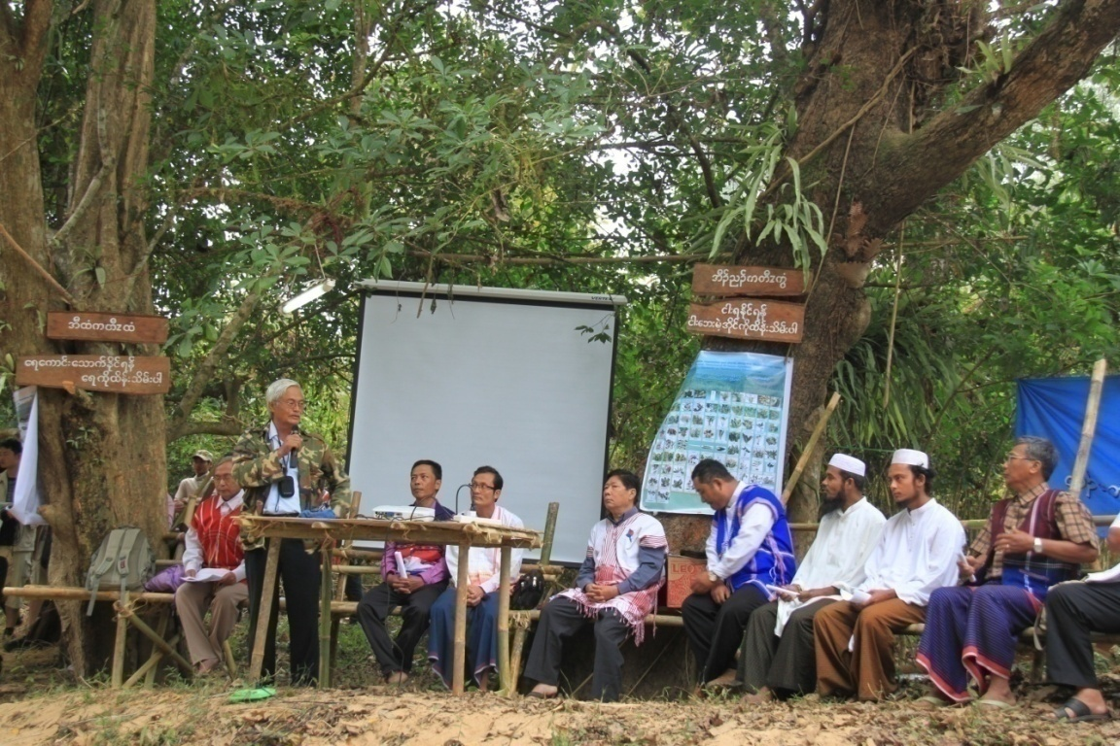
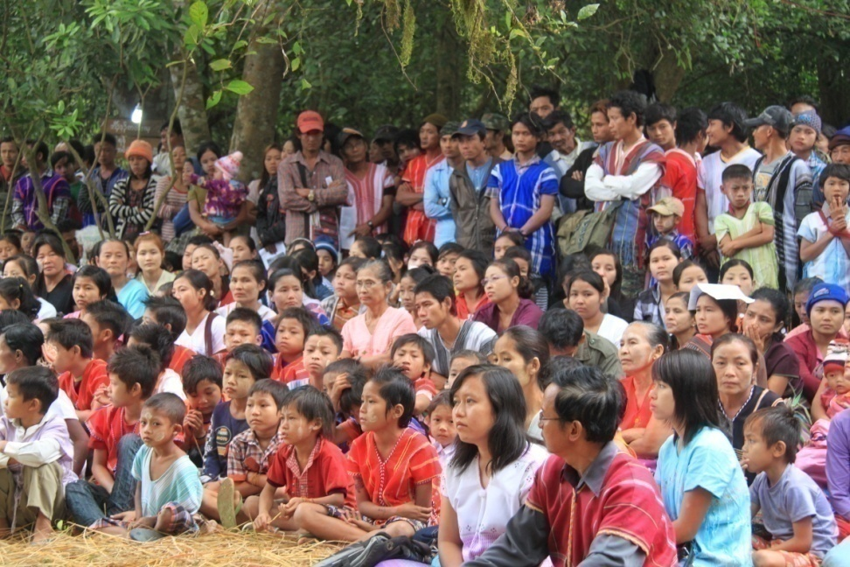
Establishment of Community Protected Areas
Participatory process whereby communities discuss, plan and actively protect important local forests and natural resources.
Community-developed conservation rules and regulations publicly posted and monitored.
Public events celebrating establishment of CPAs organized; local authorities and neighboring communities invited.

Slide 11
Conclusion
Despite political instability and a devastating civil war, local communities and CSOs are working hard to address climate change issues with limited resources and funding.
Indigenous people are actively working on watershed forest conservation as a form of climate change mitigation.
Indigenous people are reintroducing traditional methods of climate-smart agriculture production as a form of climate change adaptation.
Indigenous women’s knowledge on food production and food preserving is a form of climate change adaptation.
The escalation of civil war in Myanmar is putting pressure on the natural environment; the armed conflict is a driver of climate change.
Food shortages and starvation will happen soon because the coup-makers are blocking the delivery of humanitarian assistance to people in desperate need.
To date, most of the international responses to the humanitarian crisis in Myanmar/Burma have been slow and ineffective.

