Slide 1
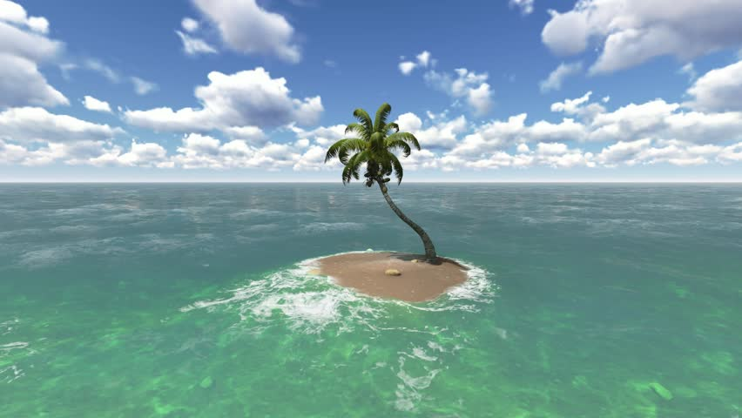
Deocene Islands in an Anthropocene Ocean:
Shifting the Conversation from Geoscience to Culture
James Rodger Fleming
jfleming@colby.edu
12th International Conference on Religion and Spirituality in Society
9-10 June, 2022

Slide 2
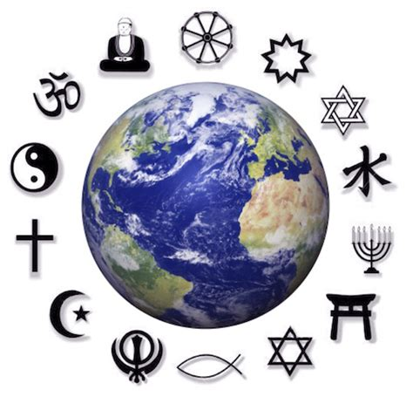

Slide 3

“Big History”

Slide 4
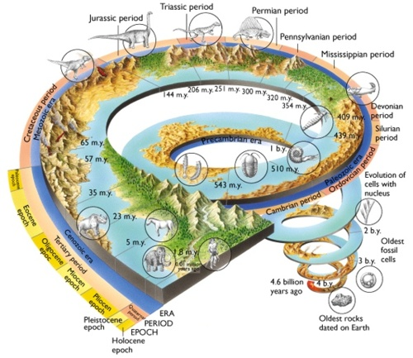
“Big History”
Practitioners of so-called “big history” claim to be providing a framework for all knowledge by incorporating cosmological, geological, biological, anthropological, and historical insights into a blended narrative of the universe and humanity’s place within it. Such historians think telling all-inclusive “just so” stories will increase the reach and relevance of history; most historians however, trained to eschew grand narratives, see such practices as little more than interdisciplinary and rather undisciplined forays into the secondary literature of other fields, potentially doing more harm than good. Grand narratives based on what we now know and value are fragile constructions at best. They are not rightfully history, since they privilege modern science and do not include human actors.

Slide 5
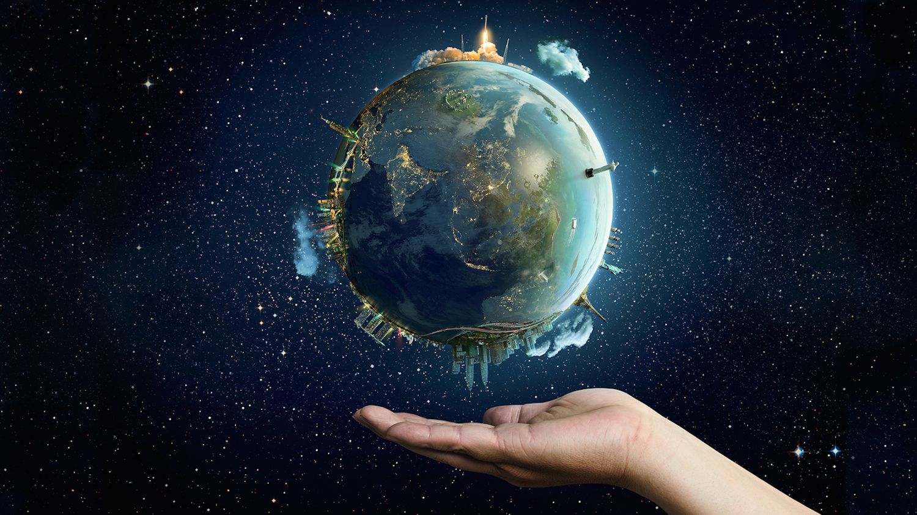
“Anthropocene”
The neologism Anthropocene (or age of humans) has recently struck a cultural nerve, pointing as it does to what may be the decisive epoch of our planet. What does it mean for humanity to be moving from the age geologists call the Holocene (recent era) — where historical records originated, to the Anthropocene —where it seems we may meet our demise? Are humanists and social scientists wise to appropriate this term, and what can we say about the history and cultural implications of what are apparently multiple Anthropocenes? What is the influence of this concept on us?

Slide 6
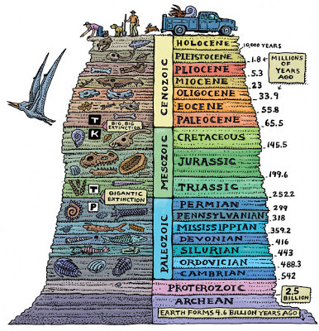

Slide 7
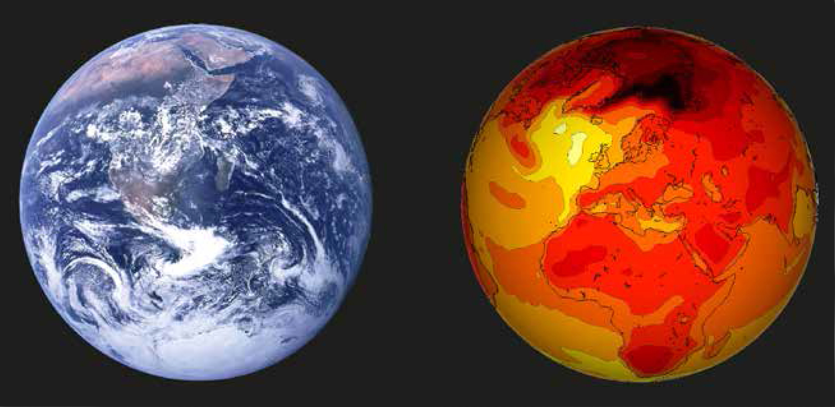

Slide 8
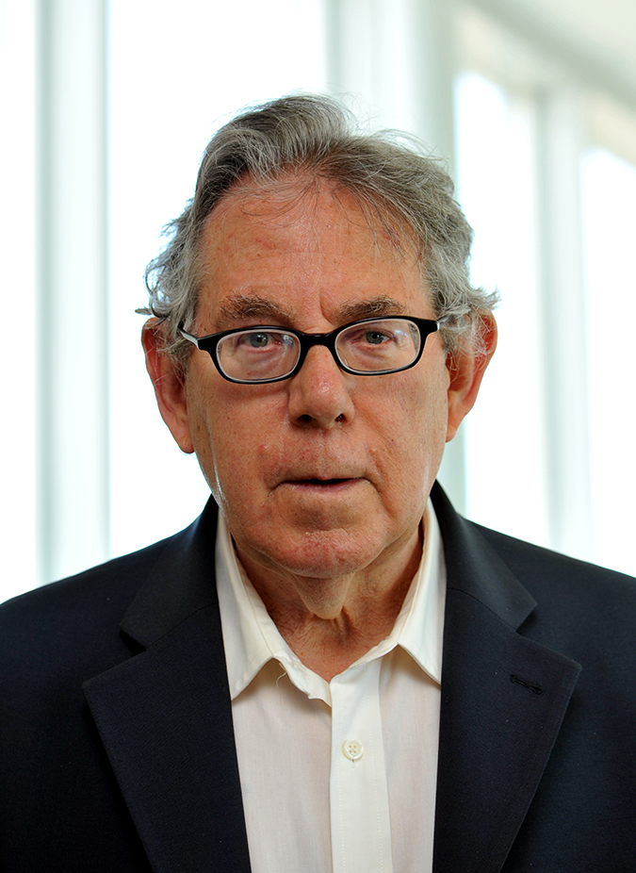
Paul Crutzen
Nobel Laureate
Ozone Depletion
Nuclear Winter
Climate Engineering
Anthropocene

Slide 9

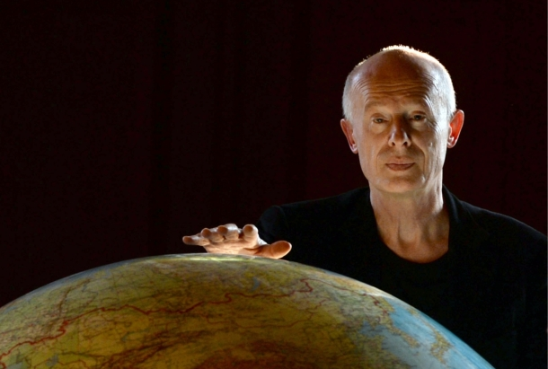
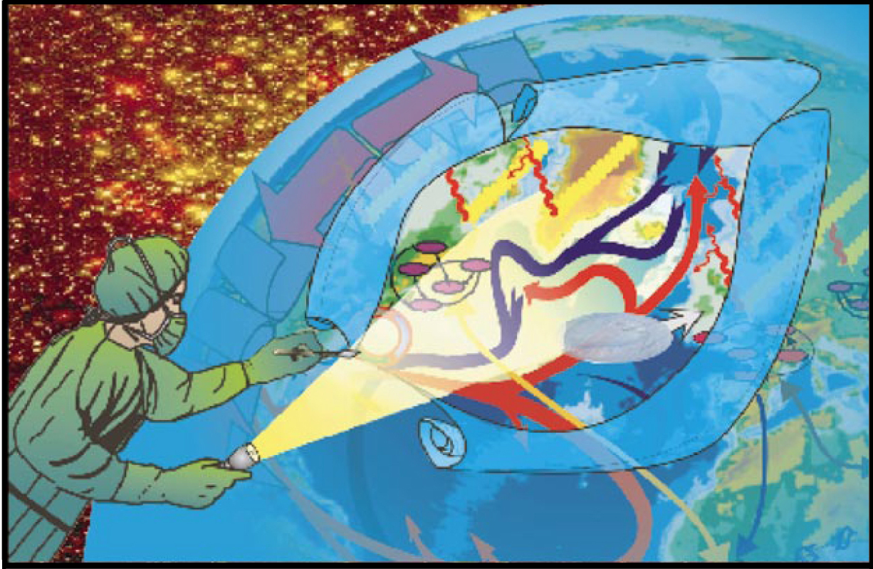

Slide 12
The Deocene and the Anthropocene
Prior to 1789 — religions formed the foundations of world cultures and dominated of everyday life and consciousness.
The good Deocene — Ethics, traditions, texts, architectures
The bad Deocene — Crusades, Inquisition, Divine Right of Kings
- - -
Since the 19th Century — unsustainable use of resources
The good Anthropocene —Democracy and human rights
The bad Anthropocene — Secularization of culture, ideologies

Slide 13
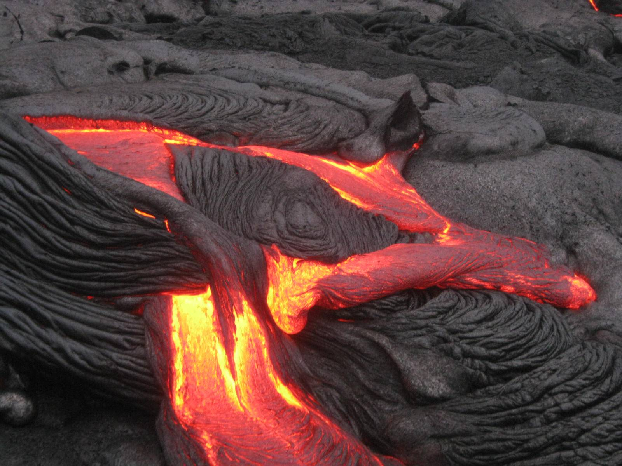

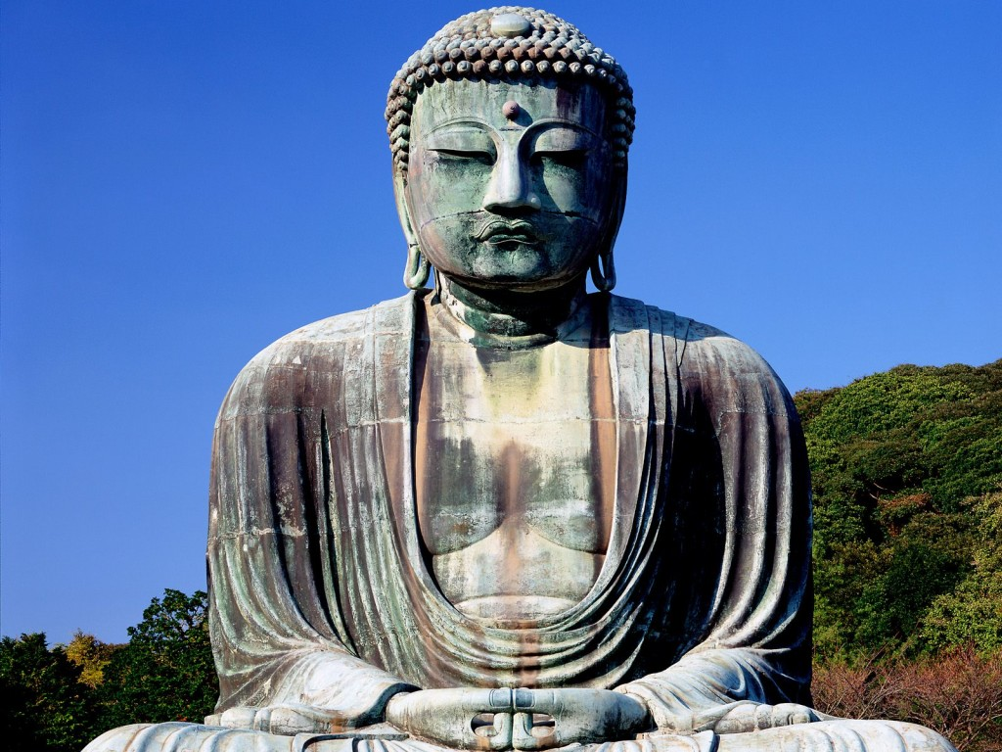
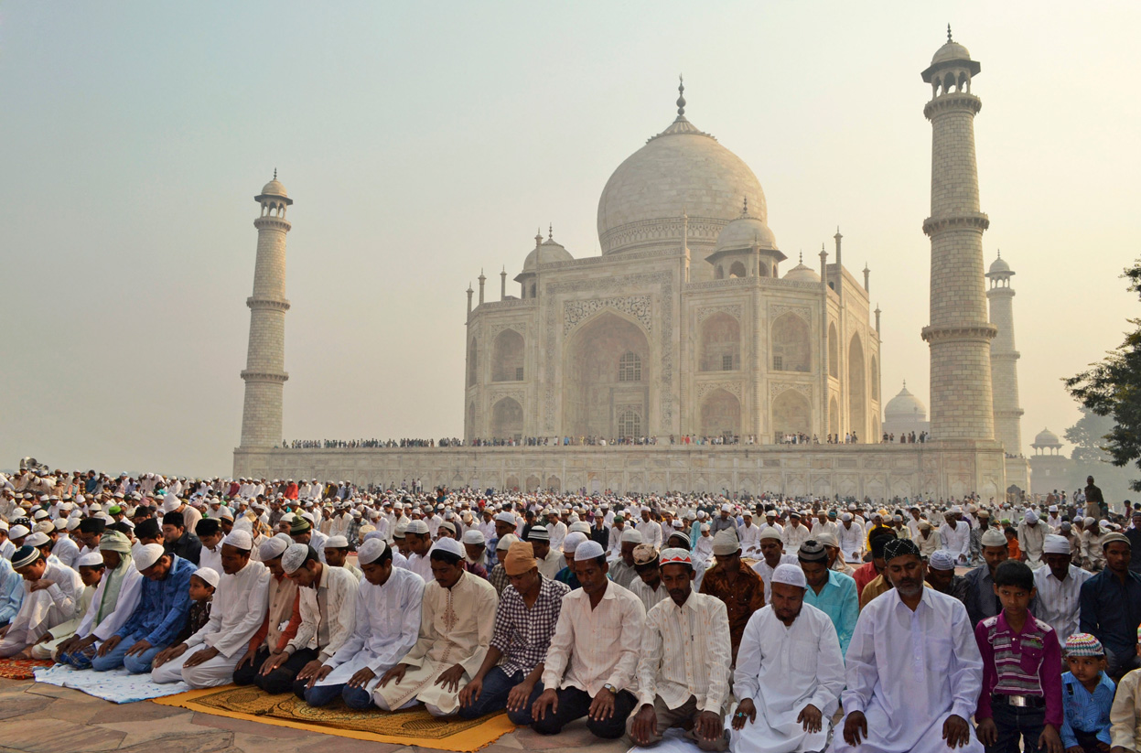

Slide 14
Thank you!
Please send comments to:
jfleming@colby.edu

